Slide 1

Frankfurt University of Applied Sciences
Analysing parameters of an HTM system, implemented for image classification
Team : Metaverse
Team Members :
Mahdie Pirmohamadian
Omid Nikbakht

Slide 2
Table of Content
Project Description
HTM
Methodology
Experiments’ results
Discussion
The prediction results
Encountered Problem

Slide 3
Project Description
In this project we have tried to find most efficient parameters of an HTM system which is implemented for image classification, so that the system provides output results with highest micro similarities, and lowest macro similarities using a training data set of images of Kaggle website.
Also, a prediction code is added, so that the trained HTM system can recognize similarity of an input test image to the trained image categories. The prediction code provides the max, min and average similarity of input test image to the trained categories.

Slide 4
Introduction
Hierarchical temporal memory (HTM) is an approach to machine learning which is inspired by the neocortex. HTM tries to take advantage of brain’s neocortex problem solving procedure to, despite other machine learning techniques, be able to solve different types of problems with almost the same architecture, as the brain.
The ,most suitable parameters are chosen , after analysing and making comparisons between the results of over100 Experiments which we have done.
The results of experiments are also illustrated in graphical representations, to give us a better overview of influences of changing the HTM parameters on output results.

Slide 5
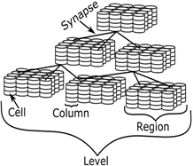
HTM
HTM, like the neocortex, consists of identical regions interconnected in hierarchy. While travelling up the hierarchy, information from several regions converges to one and vice versa.

Slide 6
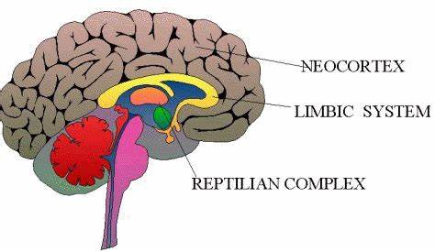
Methodology
HTM can be used for different types of problems, with different types of entry data, like the neocortex tissue of brain which is used for processing different senses of human with continual data entry.
HTM is inspired by Neocortex

Slide 7
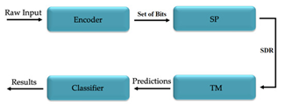
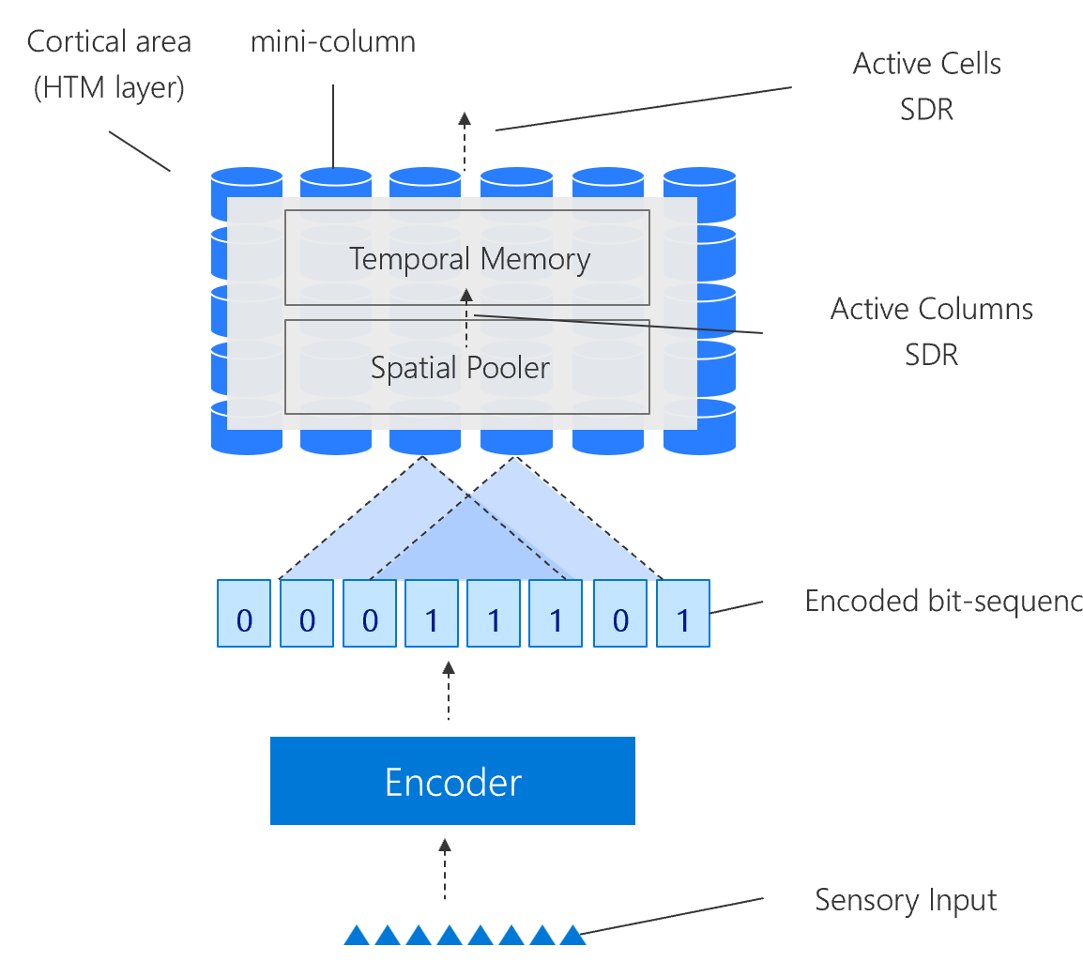
Methodology
The general overview of how HTM functions
Encoding entry data
Spatial pooling encoded data into system
Internal connections of cells in Temporal memory
Prediction and classifying the data

Slide 8
Methodology
The parameters of HTM which are investigated in this Project
PotencialRadius
localAreaDensity
NumActiveColumnsPerInhArea
GlobalInhibition

Slide 9
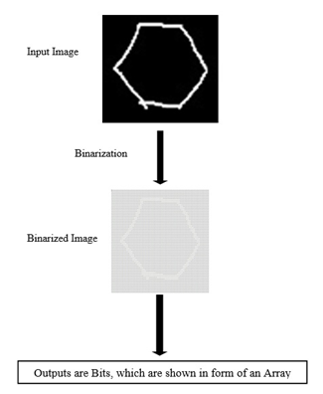
Methodology
Before the entry data is fed to system it has to be prepared and standardized by an encoder which in our case turns the training images into an array of 0s and 1s (Binarization of input).
This representation of entry data is a Sparse Distributed Representation of data also called SDR.

Slide 10
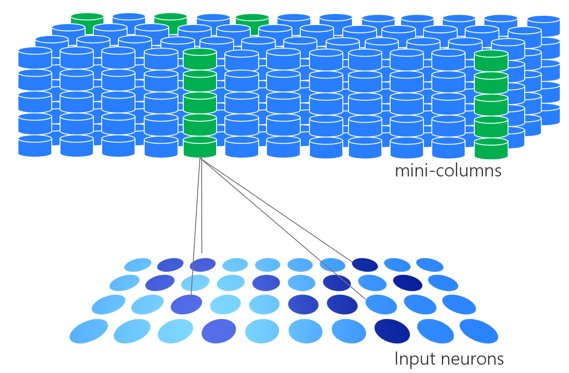
Methodology
The spatial pooler part of system is responsible for pooling the semantic information of entry data, from SDR to the columns of the HTM
According to overlap of the columns some of them get activated in their neighbourhood area (about 2%), and the rest remain inactive.
Figure spatial pooler [https://ddobric.github.io/neocortexapi/]

Slide 11
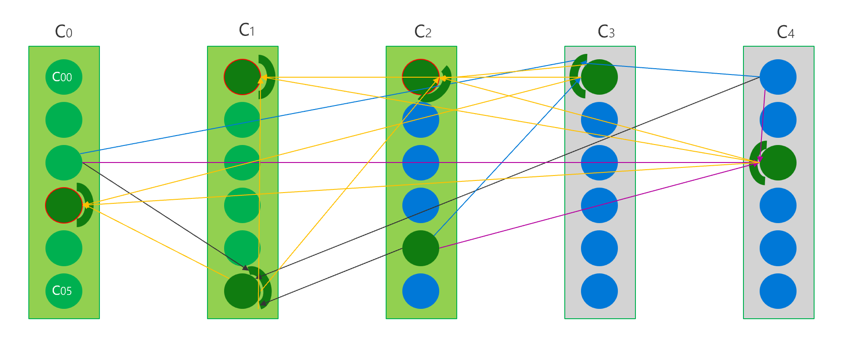
Methodology
Temporal memory is asequential memorizing technique, which helps the HTM system memorize the sequences of entry and entry pattern .
After a while that the internal synapse connections between cells of different columns are shaped, instead of the whole column, only specific cell of columns will be activated

Slide 12
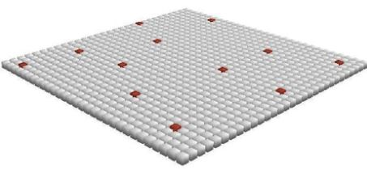
Methodology
Looking at the layer of mini-columns lets us see the unique SDR produced by HTM for each entry input
2% sparsity inspired from Neocortex
Extremely high capacity of information storage
Noise robustness

Slide 13
Methodology
The output SDRs of each entry data can be compared to others
This comparison helps the system differentiate images from each other or find similarities between them

Slide 14
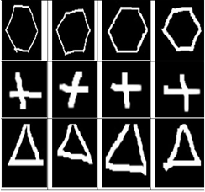
Experiments’ Results
In our investigation, HTM is trained with 3 categories of hand drawn images.
Input dataset will be encoded, and semantic characteristics of each input will be pooled into HTM by spatial pooler.

Slide 15
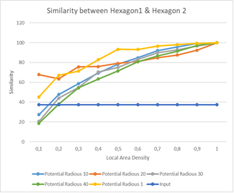
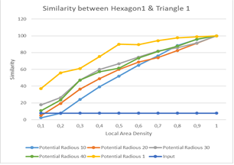
Experiment Results
Choosing the sufficient PotencialRadius parameter
A potencialRadius of 20 could be a good choice

Slide 16
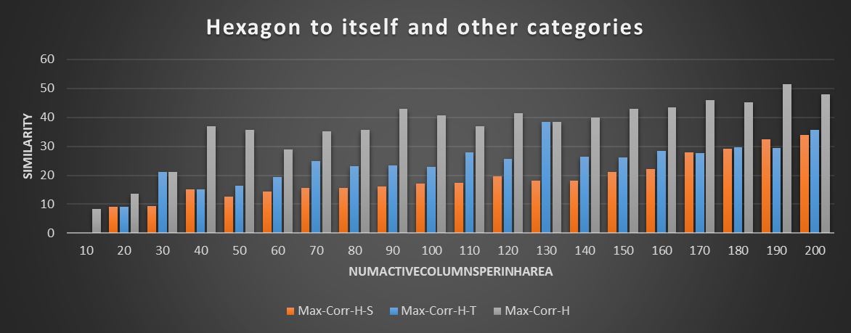
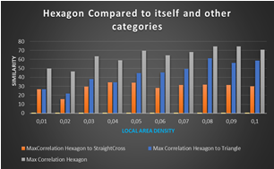
Experiments Results
Comparing results of using localAreaDensity and NumActiveColumnsPerInhArea
These two parameters both refer to sparsity of SDRs and lower values shows better functionality for both of them

Slide 17
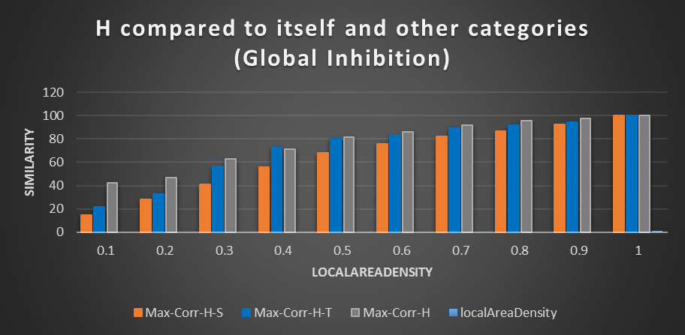
Experiments Results
Implementing GlobalInhibition does not provide us with acceptable results

Slide 18
Discussion
Choosing the desired parameters
Adding more images to each category of training dataset
Testing the functionality of system with input test images

Slide 19
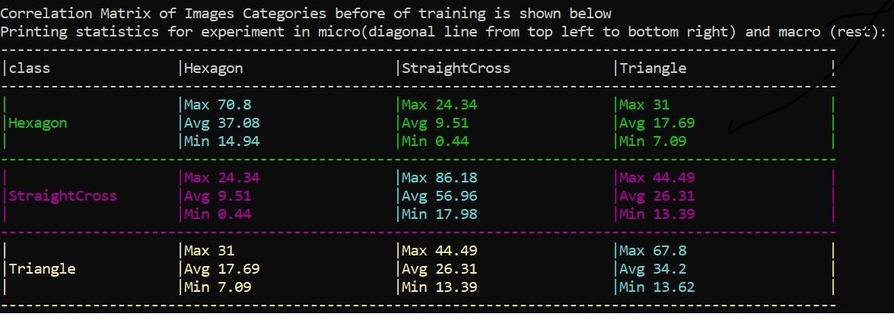
Discussion
The similarity comparison between input images of training data set before the system is trained

Slide 20
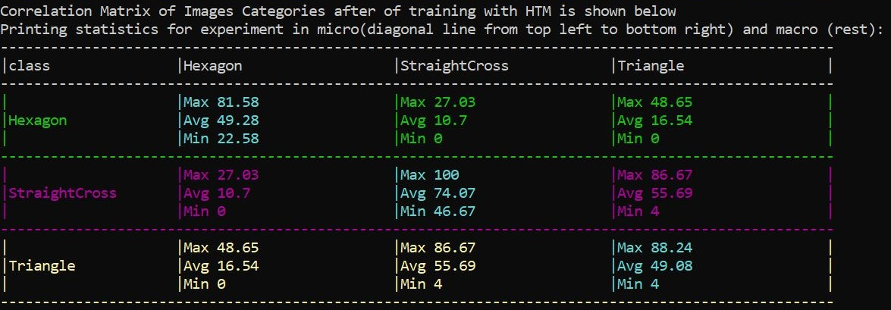
Discussion
How similar does the HTM see the input images dataset to each other, after the system is trained
HTM sees images of same categories more similar to each other after it is trained with the input dataset images.

Slide 21
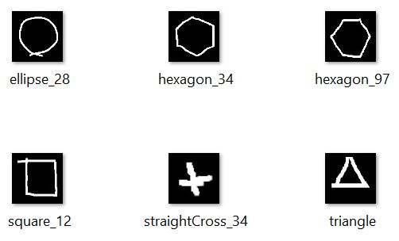
Discussion
giving the system some test input images
some images are from the same category of input image dataset, with which the system is trained, and some don’t belong to any of these categories

Slide 22
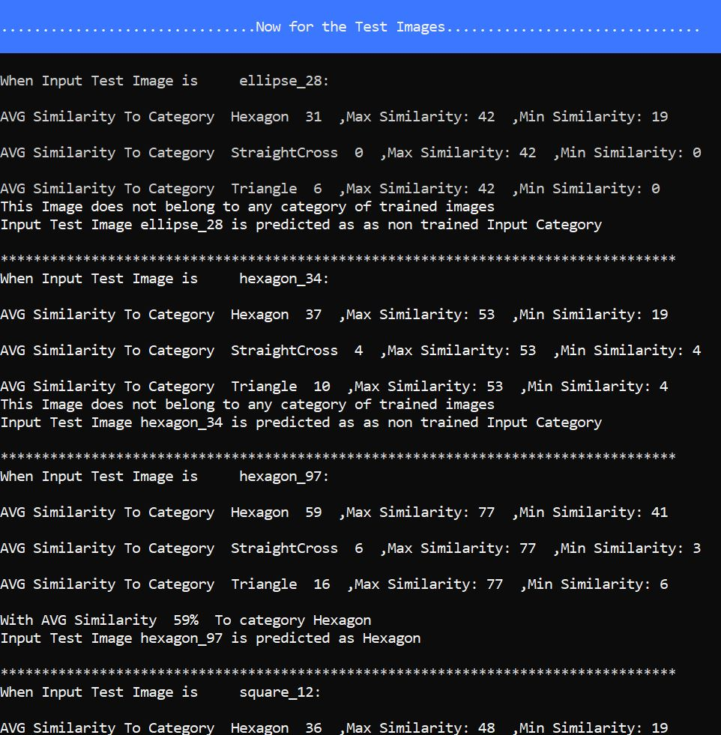
The prediction results
Maximum minimum and average similarity comparison is illustrated.
For the images which don’t belong to any of the training datasets categories, no category is chosen.
The images which, according to average calculated similarity, belong to a category of training images dataset, the recognized categories are mentioned.

Slide 23
Encountered Problem
In the first stage when we trained the spatial Pooler just with the few input images and had experiments for these training set, we found the best correlation Matrix(means Max Micro and Min Macro).
But after 100 experiments when we found the best htm configuration parameters and after setting the htm with this parameters increased the input training set to double input images this time we get unexpected high outputs for some Macro correlation which was not desired.

